Slide 1
Energy Efficiency Classification in Buildings
AIML Specialization Course
2022-26
By:
Atharva Gondhali (CS A2 - 22070122038)
Dhruva Kashyap (CS A2 - 22070122055)

Slide 2
Contents
Introduction
Literature Survey
Methodology
Result
Conclusion
Reference

Slide 3
Introduction
Energy efficiency is a critical focus in building design. This project uses the Energy Efficiency Dataset to predict heating and cooling loads of buildings based on factors like surface area, wall area, roof area, overall height, orientation, and glazing area.
Heating Load: The heating load is the energy required to maintain indoor temperatures in cold weather, influenced by insulation and outdoor temperature.
Cooling Load: The cooling load is the energy needed to cool indoor spaces in hot weather, affected by solar radiation and indoor heat generation.
Our goal is to develop a machine learning classification model to accurately predict energy consumption. The steps include data preprocessing, feature selection, model training, and performance evaluation. Accurate predictions can support energy-efficient building designs, contributing to sustainability and reduced energy demand.

Slide 4
Literature Survey
S. No | Title | Author | Work | Conclusion
1 | A Review of Cooling and Heating Loads Predictions of Residential Buildings Using Data-Driven Techniques | Fayez Abdel-Jaber, Kim N. Dirks | This paper reviews machine learning techniques for predicting heating and cooling loads in buildings, focusing on methods like ensemble learning, support vector machines (SVM), and artificial neural networks (ANN). | The study highlights the need for interpretable ML models that can assist stakeholders in designing energy-efficient buildings, noting that many existing models lack user-friendliness for practical applications.
2 | Thermal Load Prediction in Residential Buildings Using Interpretable Classification | Zhenhua Xu, Neelam Sharma, Bikas K. Sinha | This research explores classification techniques for predicting thermal loads, using machine learning methods to assess features like building orientation and insulation quality. | The study finds that interpretable classification methods effectively predict thermal loads, highlighting the importance of feature selection for improving building energy efficiency​
3 | Machine Learning Techniques for Heating Load Prediction in Buildings: A Systematic Review | N. J. Long, M. Zhang, J. Wang | This systematic review evaluates machine learning applications for predicting heating loads, analyzing different algorithms, their performances, and associated datasets while discussing challenges in interpretability and accuracy. | The review indicates that although many ML techniques show promise for heating load predictions, improvements in model interpretability and practical integration are needed for better decision-making in building design​.
4 | Optimizing Energy Efficiency: Predicting Heating Load with Machine Learning Techniques | Zhe Wang, Tianzhen Hong, and Mary Ann Piette | This study compares various machine learning models, including XGBoost and LSTM, to predict building cooling loads, assessing their performance and the effects of weather data uncertainty. | The research finds that both shallow and deep learning methods effectively predict thermal loads, with XGBoost and LSTM demonstrating strong potential for enhancing prediction accuracy.

Slide 5
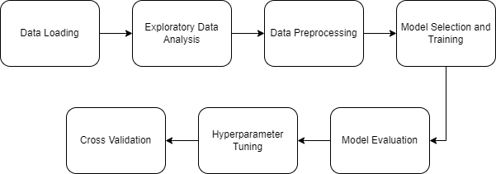
Methodology
Data Collection: Gathered the Energy Efficiency dataset, which includes features such as building orientation, glazing area, and insulation quality.
Exploratory Data Analysis (EDA): Conducted EDA to identify patterns, correlations, and anomalies within the dataset.
Data Preprocessing: Cleaned and transformed the data, handling missing values and normalizing numerical features to enhance model performance.
Model Selection: Evaluated multiple classification models, including Logistic Regression, Decision Tree, Random Forest, Gradient Boosting, and K-Nearest Neighbors.
Model Evaluation: Utilized cross-validation to assess model performance, with Gradient Boosting yielding the best results.
Hyperparameter Tuning: Fine-tuned the Gradient Boosting model, although the default configuration proved to be the most effective.
Insights and Recommendations: Provided actionable insights for enhancing building energy efficiency based on model predictions.

Slide 6
Results
Correlation Analysis: Both Heating and cooling load strongly correlate with relative compactness, surface area, roof area and overall height and the rest features have good correlation.
F1 Score:
Gradient Boosting – 0.947
Decision Tree – 0.908
Random Forest – 0.907
K-Nearest Neighbours – 0.882
Logistic Regression – 0.826
Model selected for hyperparameter tuning – Gradient Boosting
Tuned model F1 Score: 0.940
Final model selected – Untuned Gradient Boosting
Cross Validation Results:
Mean F1 Score – 0.847
Standard Deviation of F1 scores – 0.0968

Slide 7
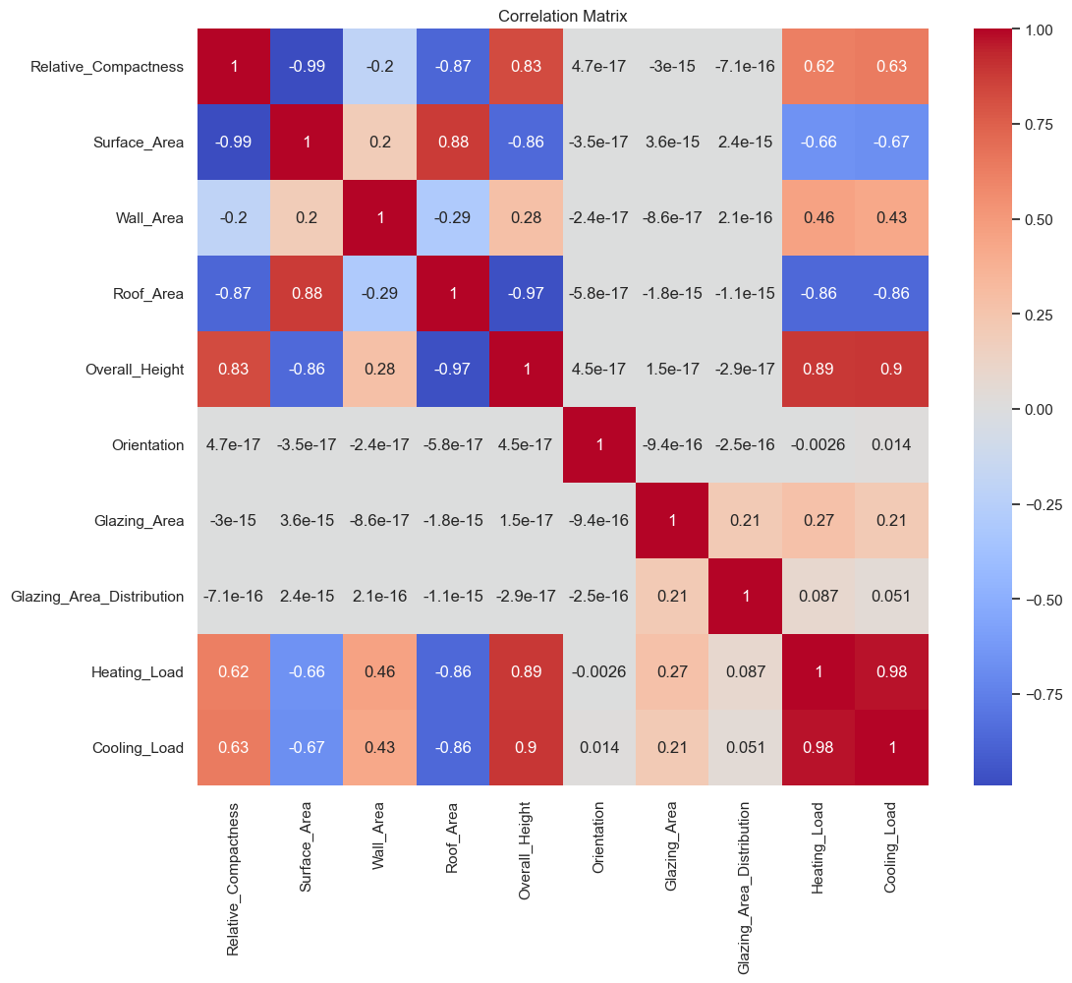
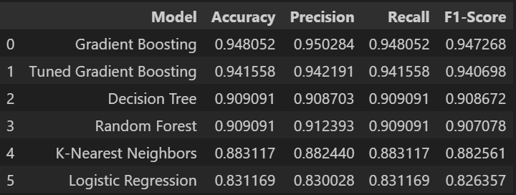
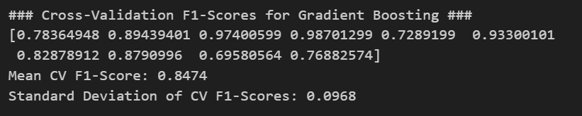
Results
Model evaluation
Correlation matrix
Final Cross validation result

Slide 8
Conclusion
In this project, we explored machine learning models for classifying building energy efficiency using architectural and environmental features.
The data is highly correlated among both independent and dependent features, which helps the model make better prediction, Gradient Boosting handles multicollinearity better, which makes it a better model.
Gradient Boosting emerged as the best-performing model, with an F1 score of 0.947, outperforming other models like Decision Tree and Random Forest.
After hyperparameter tuning, the untuned Gradient Boosting model was selected due to its robust performance. Cross-validation yielded a mean F1 score of 0.847 with a standard deviation of 0.0968, indicating stable generalization. This model provides actionable insights for optimizing energy efficiency in buildings.
This model offers valuable insights for optimizing building energy efficiency through data-driven decision-making.

Slide 9
References
Data analysis: https://www.slideshare.net/slideshow/exploratory-data-analysis-for-energy-efficiency/61812244
Dataset: https://www.kaggle.com/datasets/ujjwalchowdhury/energy-efficiency-data-set/data
Research paper:
https://www.mdpi.com/
https://www.researchgate.net/
https://eta.lbl.gov/publications

